Slide 1
Data Visualization
Muhammad Qasim

Slide 2
Seaborn
“If Matplotlib “tries to make easy things easy and hard things possible”, seaborn tries to make a well-defined set of hard things easy too” – Michael Waskom (Creator of Seaborn).
When working with Pandas, Matplotlib doesn’t serve well with DataFrames, while Seaborn functions actually work on DataFrames.
Python Seaborn library is used to ease the challenging task of data visualization
It is based on Matplotlib.

Slide 3
Seaborn
Seaborn allows the creation of statistical graphics through the following functionalities:
An API that is based on datasets allowing comparison between multiple variables
Supports multi-plot grids that in turn ease building complex visualizations
Univariate and bivariate visualizations available to compare between subsets of data
Availability of different color palettes to reveal various kinds of patterns
Estimates and plots linear regression automatically

Slide 4
Seaborn to visualize a Pandas DataFrame
DataFrames contain data structured into rows and columns.
You can create a DataFrame from a local CSV file (CSV files store data in a tabular format).
To create a DataFrame from a local CSV file you would use the syntax:
df = pd.read_csv('file_name.csv')
The code creates a DataFrame saved to a variable named df.
The data inside of the df DataFrame comes from the data in the local CSV file named file_name.csv.

Slide 5
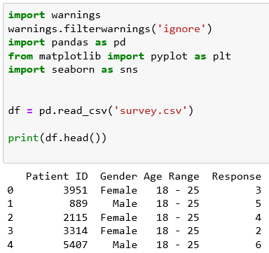
Seaborn to visualize a Pandas DataFrame
import warnings
warnings.filterwarnings('ignore')
import pandas as pd
from matplotlib import pyplot as plt
import seaborn as sns
df = pd.read_csv('survey.csv')
print(df.head())

Slide 6
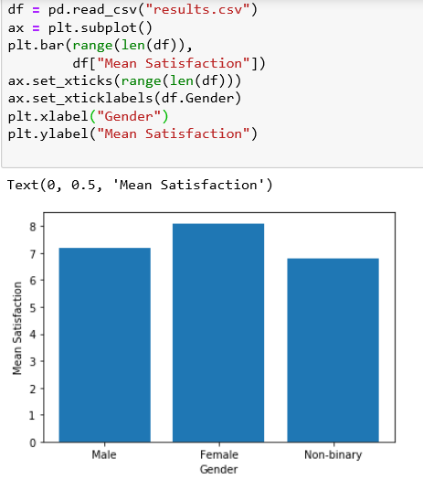
Plotting Bars with Matplotlab vs Seaborn
Problem: Suppose we are analyzing data from a survey: we asked 1,000 patients at a hospital how satisfied they were with their experience. Their response was measured on a scale of 1 - 10, with 1 being extremely unsatisfied, and 10 being extremely satisfied. We have summarized that data in a CSV file called results.csv.
df = pd.read_csv("results.csv")
ax = plt.subplot()
plt.bar(range(len(df)), df["Mean Satisfaction"])
ax.set_xticks(range(len(df)))
ax.set_xticklabels(df.Gender)
plt.xlabel("Gender")
plt.ylabel("Mean Satisfaction")

Slide 7
Plotting Bars with Matplotlab vs Seaborn
The Seaborn function sns.barplot(), takes at least three keyword arguments:
data: a Pandas DataFrame that contains the data (in this example, data=df)
x: a string that tells Seaborn which column in the DataFrame contains other x-labels (in this case, x="Gender")
y: a string that tells Seaborn which column in the DataFrame contains the heights we want to plot for each bar (in this case y="Mean Satisfaction")
By default, Seaborn will aggregate and plot the mean of each category.

Slide 8
Task 1:
1. Use Pandas to load in the data from results.csv and save it to the variable df.
2. Display df using print
3. Remove all of the # characters from in front of the sns.barplot command and fill in the missing values.
4. Type plt.show() to display the completed bar plot.
import warnings
warnings.filterwarnings('ignore')
import pandas as pd
from matplotlib import pyplot as plt
import seaborn as sns
# Load results.csv here:
# sns.barplot(
# data= ,
# x= ,
# y=
# )

Slide 9
Understanding Aggregates
Seaborn can also calculate aggregate statistics for large datasets.
An aggregate statistic, or aggregate, is a single number used to describe a set of data. One example of an aggregate is the average, or mean of a data set.
Suppose we have a grade book with columns student, assignment_name, and grade, as shown below.
To calculate a student’s current grade in the class, we need to aggregate the grade data by student.
student | assignment_name | grade
Amy | Assignment 1 | 75
Amy | Assignment 2 | 82
Bob | Assignment 1 | 99
Bob | Assignment 2 | 90
Chris | Assignment 1 | 72
Chris | Assignment 2 | 66
… | … | …
student | grade
Amy | 78.5
Bob | 94.5
Chris | 69
… | …
assignment_name | grade
Assignment 1 | 82
Assignment 2 | 79.3
… | …

Slide 10
import codecademylib3_seaborn
import pandas as pd
from matplotlib import pyplot as plt
gradebook = pd.read_csv("gradebook.csv")
Task 2:
In Python, you can compute aggregates fairly quickly and easily using Numpy.
To calculate aggregates using Numpy, you’ll first need to import the Numpy library
import numpy as np
The DataFrame gradebook contains the complete gradebook for a hypothetical classroom. Use print to examine gradebook.
Select all rows from the gradebook DataFrame where assignment_name is equal to Assignment 1. Save the result to the variable assignment1. Print assignment1.
Now use Numpy to calculate the median grade in assignment1. Use np.median() to calculate the median of the column grade from assignment1 and save it to asn1_median.
Display asn1_median using print. What is the median grade on Assignment 1?

Slide 11
student | assignment_name | grade
Amy | Assignment 1 | 75
Amy | Assignment 2 | 82
Bob | Assignment 1 | 99
Bob | Assignment 2 | 90
Chris | Assignment 1 | 72
Chris | Assignment 2 | 66
… | … | …
Plotting Aggregates using Seaborn
Suppose this data is stored in a Pandas DataFrame called df.
The Seaborn command (sns.barplot()) will plot this data in a bar plot and automatically aggregate the data:
sns.barplot(data=df, x="student", y="grade")
In the example above, Seaborn will aggregate grades by student, and plot the average grade for each student.
Task 3:
1. Use Seaborn to plot the average grade for each assignment. Take a look at gradebook.csv for the column names.
2. Use plt.show() to display the graph.

Slide 12

Modifying Error Bars
By default, Seaborn will place error bars on each bar when you use the barplot() function.
For example, in our assignment average example, an error bar might indicate what grade we expect an average student to receive on this assignment.
By default, Seaborn uses a bootstrapped confidence interval.
This interval means that “based on this data, 95% of similar situations would have an outcome within this range”.
In our gradebook example, the confidence interval for the assignments means “if we gave this assignment to many, many students, we’re confident that the mean score on the assignment would be within the range represented by the error bar”.

Slide 13
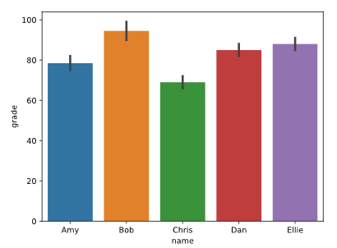
Modifying Error Bars
If you’re calculating a mean and would prefer to use standard deviation for your error bars, you can pass in the keyword argument ci="sd" to sns.barplot() which will represent one standard deviation.
sns.barplot(data=gradebook, x="name", y="grade", ci="sd")
Task 4:
Modify the bar plot so that the error bars represent one standard deviation, rather than 95% confidence intervals.
gradebook = pd.read_csv("gradebook.csv")
sns.barplot(data=gradebook, x="name", y="grade", ci="sd")
plt.show()

Slide 14
Calculating Different Aggregates
In most cases, we’ll want to plot the mean of our data, but sometimes, we’ll want something different:
If our data has many outliers, we may want to plot the median.
If our data is categorical, we might want to count how many times each category appears (such as in the case of survey responses).
To do so, you’ll need to use the keyword argument estimator, which accepts any function that works on a list.
For example, to calculate the median, you can pass in np.median to the estimator keyword:
Consider the data in results.csv. To calculate the number of times a particular value appears in the Response column , we pass in len:
sns.barplot(data=df,
x="x-values",
y="y-values",
estimator=np.median)
sns.barplot(data=df,
x="Patient ID",
y="Response",
estimator=len)

Slide 15
Task 5:
1. Consider our hospital satisfaction survey data, which is loaded into the Pandas DataFrame df. Use print to examine the data.
2. We’d like to know how many men and women answered the survey. Use sns.barplot() with:
data equal to df
x equal to Gender
y equal to Response
estimator equal to len
3. Change sns.barplot() to graph the median Response aggregated by Gender using estimator=np.median.
import warnings
warnings.filterwarnings('ignore')
import numpy as np
import pandas as pd
from matplotlib import pyplot as plt
import seaborn as sns
df = pd.read_csv("survey.csv")

Slide 16
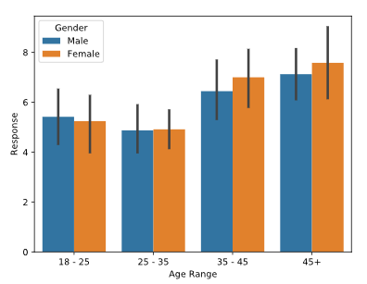
Aggregating by Multiple Columns
For example, consider our hospital survey data. The mean satisfaction seems to depend on Gender, but it might also depend on another column: Age Range.
We can compare both the Gender and Age Range factors at once by using the keyword hue.
sns.barplot(data=df,
x="Gender",
y="Response",
hue="Age Range")
The hue parameter adds a nested categorical variable to the plot.
Visualizing survey results by gender with age range nested

Slide 17
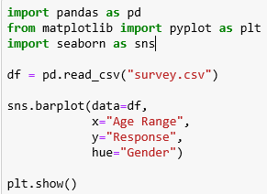
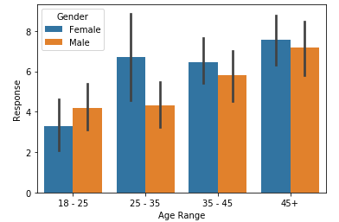
Visualizing survey results by gender with age range nested
import pandas as pd
from matplotlib import pyplot as plt
import seaborn as sns
df = pd.read_csv("survey.csv")
sns.barplot(data=df,
x="Age Range",
y="Response",
hue="Gender")
plt.show()

Slide 18
Load_dataset with Seaborn
Import the required libraries as follows:
import numpy as np
import pandas as pd
import matplotlib.pyplot as plt
import seaborn as sns
sns.set(style="darkgrid")
Style attribute is also customizable and can take any value such as darkgrid, ticks, etc.
Seaborn allows you to load any dataset from GIT using the load_dataset() function.
f = sns.load_dataset("flights")
You can also view all the available datasets using get_dataset_names() function as follows:
sns.get_dataset_names()

Slide 19
relplot():
This is a figure-level-function that makes use of two other axes functions for Visualizing Statistical Relationships which are:
scatterplot()
lineplot()
These functions can be specified using the ‘kind’ parameter of relplot().
It takes the default one which is scatterplot().

Slide 20
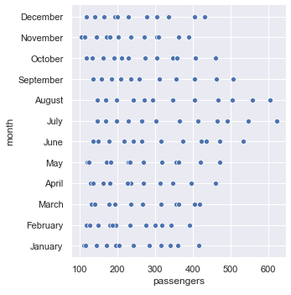
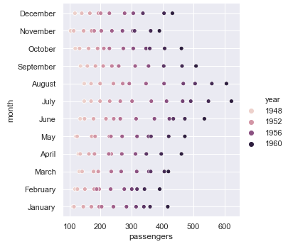
relplot():
f = sns.load_dataset("flights")
sns.relplot(x="passengers", y="month", data=f);
f = sns.load_dataset("flights")
sns.relplot(x="passengers", y="month", hue="year", data=f);
We can add another dimension using the ‘hue’.

Slide 21
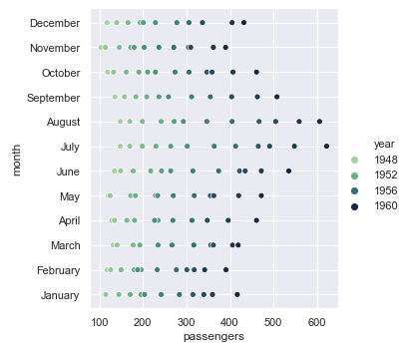
More customizations
sns.set(style="darkgrid")
f = sns.load_dataset("flights")
sns.relplot(x="passengers", y="month", hue="year", palette="ch:r=-.5,l=.75", data=f);

Slide 22
Plotting Distributions with Seaborn
Seaborn is optimized to work with large datasets — from its ability to natively interact with Pandas DataFrames, to automatically calculating and plotting aggregates.
One of the most powerful aspects of Seaborn is its ability to visualize and compare distributions.
Distributions provide us with more information about our data — how spread out it is, its range, etc.
Seaborn includes several plots that allow you to graph univariate distribution, including KDE plots, box plots, and violin plots.

Slide 23
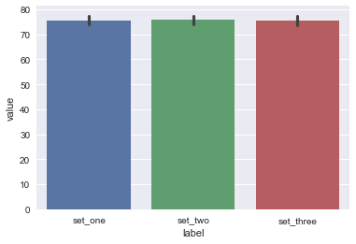
Plotting Distributions with Seaborn
import numpy as np
import pandas as pd
import matplotlib.pyplot as plt
import seaborn as sns
n = 500
dataset1 = np.genfromtxt("dataset1.csv", delimiter=",")
dataset2 = np.genfromtxt("dataset2.csv", delimiter=",")
dataset3 = np.genfromtxt("dataset3.csv", delimiter=",")
df = pd.DataFrame({
"label": ["set_one"] * n + ["set_two"] * n + ["set_three"] * n,
"value": np.concatenate([dataset1, dataset2, dataset3])
})
sns.set()
sns.barplot(data=df, x='label', y='value')
plt.show()

Slide 24
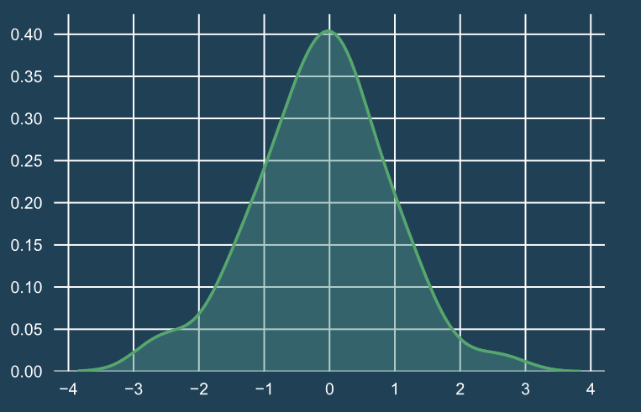
KDE Plots
KDE stands for Kernel Density Estimator. A KDE plot gives us the sense of a univariate as a curve.
A univariate dataset only has one variable
KDE plots are preferable to histograms because depending on how you group the data into bins and the width of the bins, you can draw wildly different conclusions about the shape of the data.
Using a KDE plot can mitigate these issues, because they smooth the datasets, allow us to generalize over the shape of our data

Slide 25
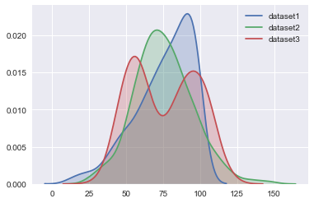
KDE Plots
To plot a KDE in Seaborn, we use the method sns.kdeplot().
A KDE plot takes the following arguments:
data - the univariate dataset being visualized, like a Pandas DataFrame, Python list, or NumPy array
shade - a boolean that determines whether or not the space underneath the curve is shaded
Let’s examine the KDE plots of our three datasets:
sns.kdeplot(dataset1, shade=True)
sns.kdeplot(dataset2, shade=True)
sns.kdeplot(dataset3, shade=True)
plt.legend()
plt.show()
Dataset 1 is skewed left
Dataset 2 is normally distributed
Dataset 3 is bimodal (it has two peaks)

Slide 26
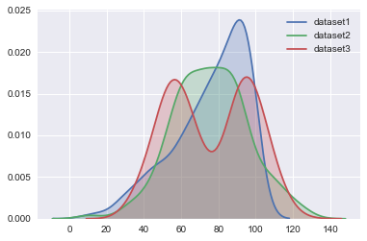
KDE Plots
We can use barplots to find out information about the mean - but it doesn't give us a sense of how spread out the data is in each set.
To find out more about the distribution, we can use a KDE plot.
sns.kdeplot(dataset1, shade=True, label="dataset1")
sns.kdeplot(dataset2, shade=True, label="dataset2")
sns.kdeplot(dataset3, shade=True, label="dataset3")
plt.legend()
plt.show()

Slide 27
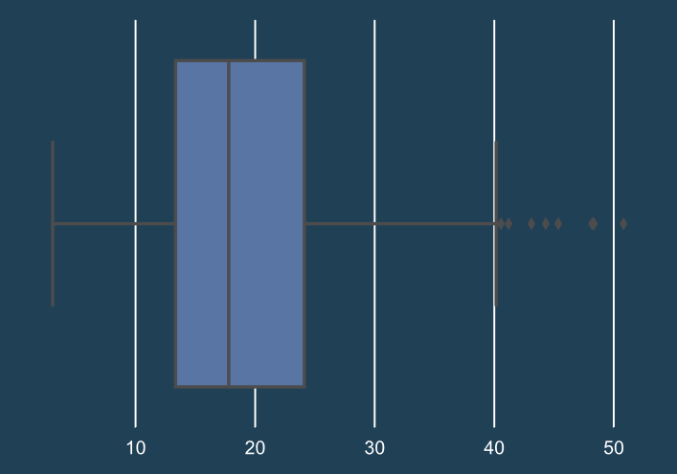
Box Plots
The box plot (also known as a box-and-whisker plot) can tell us about how our dataset is distributed.
It gives us an idea about where a significant portion of our data lies, and whether or not any outliers are present.
The box represents the interquartile range
The line in the middle of the box is the median
The end lines are the first and third quartiles
The diamonds show outliers
However, we lose the ability to determine
the shape of the data

Slide 28
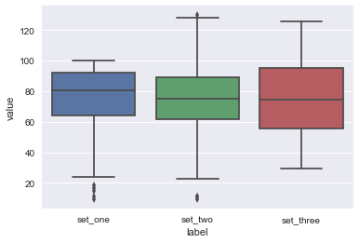
Box Plots
A box plot takes the following arguments:
data - the dataset we’re plotting, like a DataFrame, list, or an array
x - a one-dimensional set of values, like a Series, list, or array
y - a second set of one-dimensional data
sns.boxplot(data=df, x='label', y='value')
plt.show()
if you use the value Series as your y value data, Seaborn will automatically apply that name as the y-axis label.

Slide 29
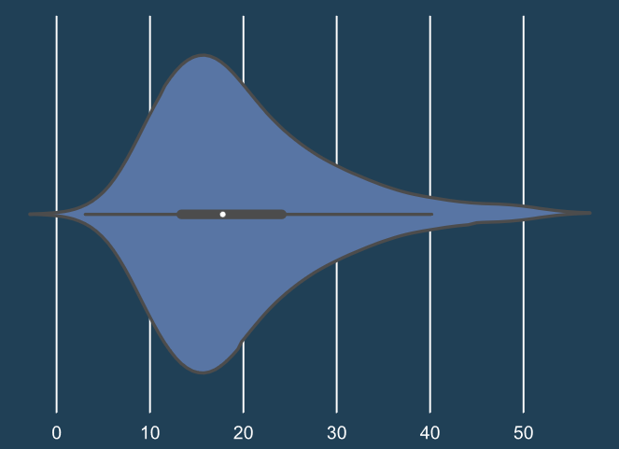
Violin plots
Violin plots provide more information than box plots because instead of mapping each individual data point, we get an estimation of the dataset using the KDE.
There are two KDE plots that are symmetrical along the center line.
A white dot represents the median.
The thick black line in the center of each violin represents the interquartile range.
The lines that extend from the center are the confidence intervals - just as we saw on the bar plots, a violin plot also displays the 95% confidence interval.

Slide 30
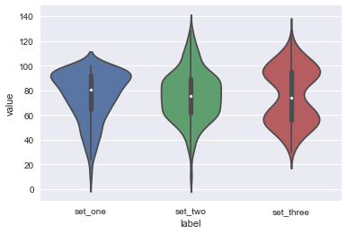
Violin plots
A violin plot brings together shape of the KDE plot with additional information that a box plot provides.
sns.violinplot(data=df, x="label", y="value")
plt.show()

Slide 31
Seaborn Styling, Part 1: Figure Style and Scale
Styling is the process of customizing the overall look of your visualization, or figure.
Making intentional decisions about the details of the visualization will increase their impact
Seaborn enables you to change the presentation of your figures by changing the style of elements like the background color, grids, and spines.
1. Built-in Themes:
Seaborn has five built-in themes to style its plots: darkgrid, whitegrid, dark, white, and ticks.
Seaborn defaults to using the darkgrid theme for its plots

Slide 32
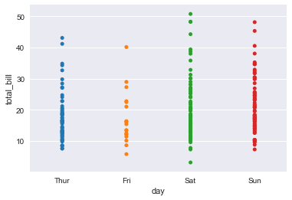
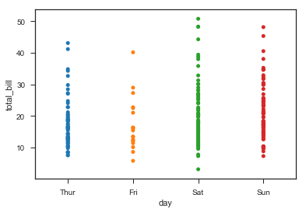
Seaborn Styling, Part 1: Figure Style and Scale
To use any of the preset themes pass the name of it to sns.set_style().
sns.set_style("darkgrid")
sns.stripplot(x="day", y="total_bill", data=tips)
The white and tick themes will allow the colors of your dataset to show more visibly and provides higher contrast so your plots are more legible:
sns.set_style("ticks")
sns.stripplot(x="day", y="total_bill", data=tips)

Slide 33
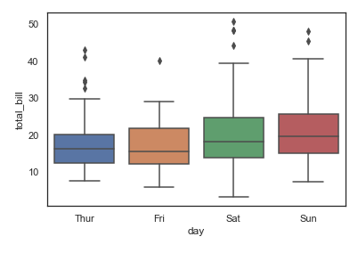
Styling:
import seaborn as sns
import matplotlib.pyplot as plt
sns.set(style="white", color_codes=True)
a = sns.load_dataset("tips")
sns.boxplot(x="day", y="total_bill", data=a);
Theme is changed to white

Slide 34
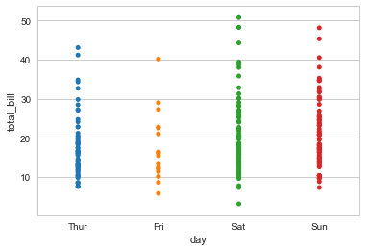
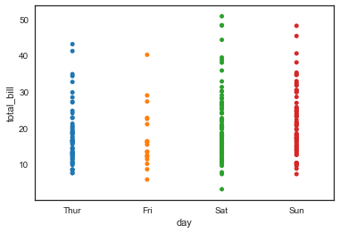
Seaborn Styling, Part 1: Figure Style and Scale 2. Grids:
To define the background color of your figure, you can also choose whether or not to include a grid.
A grid allows the audience to read your chart and get specific information about certain values. Research papers and reports are a good example of when you would want to include a grid.
sns.set_style("whitegrid")
sns.stripplot(x="day", y="total_bill", data=tips)
There are also instances where it would make more sense to not use a grid.
sns.set_style("white")
sns.stripplot(x="day", y="total_bill", data=tips)

Slide 35
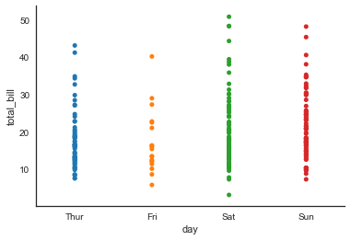
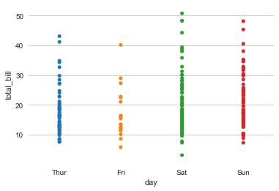
Seaborn Styling, Part 1: Figure Style and Scale 3. Despine
Spines are the borders of the figure that contain the visualization.
By default, an image has four spines.
You can automatically take away the top and right spines using the sns.despine()function.
sns.set_style("white")
sns.stripplot(x="day", y="total_bill", data=tips)
sns.despine()
You can also specify how many spines you want to include by calling despine() and passing in the spines you want to get rid of, such as: left, bottom, top, right.
sns.set_style("whitegrid")
sns.stripplot(x="day", y="total_bill", data=tips)
sns.despine(left=True, bottom=True)

Slide 36
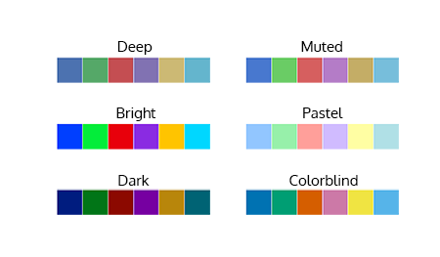

Seaborn Styling, Part 1: Figure Style and Scale
4. Working with Palettes
You can build color palettes using the function sns.color_palette().
This function can take any of the Seaborn built-in palettes (see below). You can also build your own palettes
use the function sns.palplot() to plot a palette as an array of colors
# Save a palette to a variable:
palette = sns.color_palette("bright")
# Use palplot and pass in the variable:
sns.palplot(palette)

Slide 37
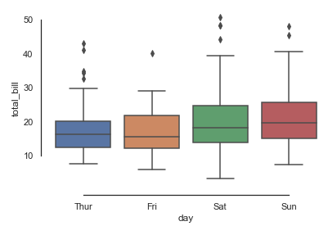
import seaborn as sns
import matplotlib.pyplot as plt
sns.set(style="white", color_codes=True)
a = sns.load_dataset("tips")
sns.boxplot(x="day", y="total_bill", data=a);
sns.despine(offset=10, trim=True);

Slide 38
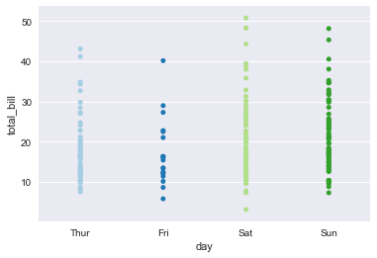
4. Working with Palettes
To select and set a palette in Seaborn, use the command sns.set_palette() and pass in the name of the palette that you would like to use:
# Set the palette using the name of a palette:
sns.set_palette("Paired")
# Plot a chart:
sns.stripplot(x="day", y="total_bill", data=tips)

Slide 39
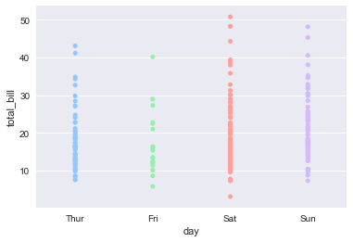
4. Working with Palettes
To use one of these palettes, pass the name into sns.set_palette():
# Set the palette to the "pastel" default palette:
sns.set_palette("pastel")
# plot using the "pastel" palette
sns.stripplot(x="day", y="total_bill", data=tips)

Slide 40
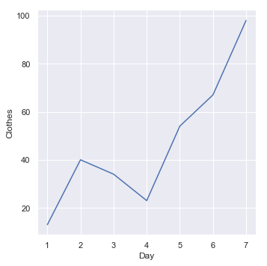
lineplot():
This function will allow you to draw a continuous line for your data. You can use this function by changing the ‘kind’ parameter as follows:
a=pd.DataFrame({'Day':[1,2,3,4,5,6,7],'Grocery':[30,80,45,23,51,46,76],'Clothes':[13,40,34,23,54,67,98],'Utensils':[12,32,27,56,87,54,34]},index=[1,2,3,4,5,6,7])
sns.relplot(x="Day", y="Clothes", kind="line", data=a)

Slide 41
Plotting with Categorical Data:
This approach is used when our main variable is further divided into discrete groups (categorical).
This can be achieved using the catplot() function.
catplot():
It can be characterized by three families of axes level functions namely:
Scatterplots – These include stripplot(), swarmplot()
Distribution Plots – which are boxplot(), violinplot(), boxenplot()
Estimateplots – namely pointplot(), barplot(), countplot()

Slide 42
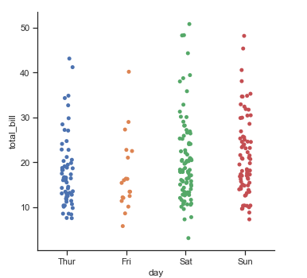
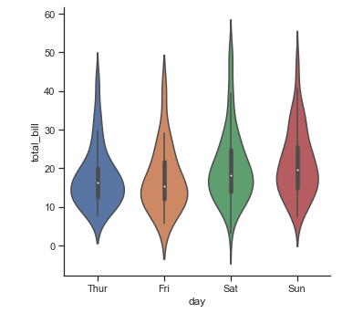
Plotting with Categorical Data:
import seaborn as sns
import matplotlib.pyplot as plt
sns.set(style="ticks", color_codes=True)
a = sns.load_dataset("tips")
sns.catplot(x="day", y="total_bill", data=a);
_____________________________________________________
import seaborn as sns
import matplotlib.pyplot as plt
sns.set(style="ticks", color_codes=True)
a = sns.load_dataset("tips")
sns.catplot(x="day", y="total_bill", kind="violin", data=a);

Slide 43
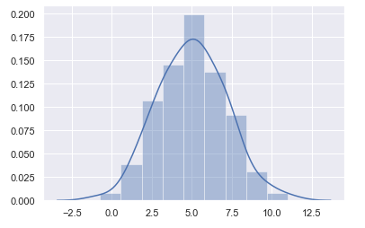
Visualizing the distribution of a dataset:
Plotting Univariate distributions: To plot them, you can make use of distplot() function as follows:
import numpy as np
import pandas as pd
import seaborn as sns
import matplotlib.pyplot as plt
from scipy import stats
sns.set(color_codes=True)
a = np.random.normal(loc=5,size=100,scale=2)
sns.distplot(a);
We have plotted a graph for the variable a whose values are generated by the normal() function using distplot

Slide 44
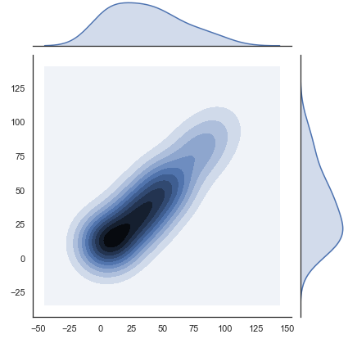
Plotting bivariate distributions:
When you have two random independent variables resulting in some probable event, then you can use a bivariate distribution
The best function to plot these type of graphs is jointplot().
x=pd.DataFrame({'Day':[1,2,3,4,5,6,7],'Grocery':[30,80,45,23,51,46,76],'Clothes':[13,40,34,23,54,67,98],'Utensils':[12,32,27,56,87,54,34]},index=[1,2,3,4,5,6,7])
y=pd.DataFrame({'Day':[8,9,10,11,12,13,14],'Grocery':[30,80,45,23,51,46,76],'Clothes':[13,40,34,23,54,67,98],'Utensils':[12,32,27,56,87,54,34]},index=[8,9,10,11,12,13,14])
mean, cov = [0, 1], [(1, .5), (.5, 1)]
data = np.random.multivariate_normal(mean, cov, 200)
with sns.axes_style("white"):
sns.jointplot(x=x, y=y, kind="kde", color="b");

Slide 45
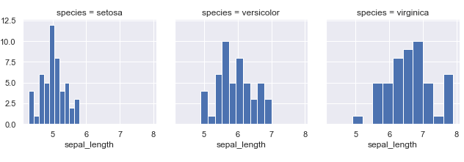
Multi-Plot Grids:
Python Seaborn allows you to plot multiple grids side-by-side.
These are basically plots or graphs that are plotted using the same scale and axes to aid comparison between them.
Use facetgrid() function to plot these graphs.
sns.set(style="darkgrid")
a = sns.load_dataset("iris")
b = sns.FacetGrid(a, col="species")
b.map(plt.hist, "sepal_length");

Slide 46
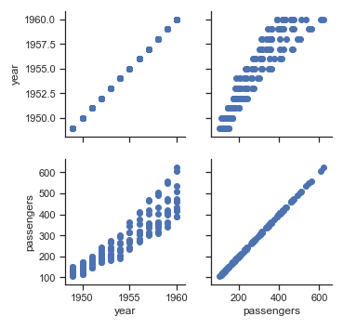
Multi-Plot Grids:
You can also plot using PairGrid function when you have a pair of variables to compare.
sns.set(style="ticks")
a = sns.load_dataset("flights")
b = sns.PairGrid(a)
b.map(plt.scatter);
The output clearly compares between the year and the number of passengers in different ways.

